Slide 1
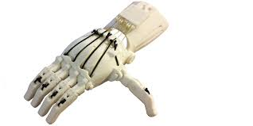
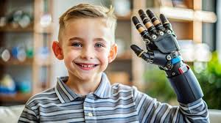

EMG-Based Smart Prosthetic Hand
By Anmol Gurung

Slide 2

Overview
This project explores an affordable smart prosthetic hand designed for people living in resource-limited settings.
The system uses electromyography (EMG) signals collected from the user’s electrical activity in the forearm muscles via nerves, to control hand gestures.
AI-based function to gather data information to recognize signal patterns , allows the prosthetic to perform basic movements such as open, close, pinch, and rest.
A 3D‑printed structure keeps the device lightweight, repairable, and low-cost to build at around £120.

Slide 3
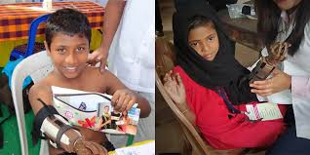
Problems Leading to Motivation
Losing a hand drastically changes daily life, and modern prosthetics are often too expensive for people in developing countries.
Commercial myoelectric prosthetic hands cost upwards of £5,000, making them inaccessible to most
High workplace injury rates in low‑income regions increase the need for affordable assistive devices.
This project aims to close the gap by creating a functional, low-cost prosthetic that uses easily available components.

Slide 4
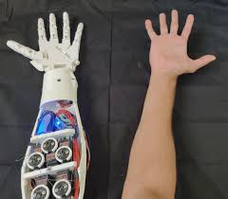
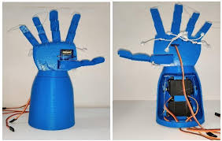
System Design
The hand is built using 3D‑printed parts to ensure low cost, easy repairs, and customizable fitting. Uses PLA (Polylactic Acid) an inexpensive material used for main structure ABS (Acrylonitrile Butadiene Styrene): Known for durability. Costs 120 pounds.
Servo motors provide motion for the fingers and wrist, offering reliable and energy‑efficient actuation.
Surface EMG sensors placed on the forearm detect muscle activity during intended hand movements.
A microcontroller interprets the EMG signals using AI and sends commands to the servo motors in real time.

Slide 5

Signal Processing & Machine Learning
Raw EMG signals are often noisy due to movement artifacts and interference, so preprocessing of the signal is essential.
Use band‑pass filtering removes unwanted noise and electrical interference.
Machine AI learning algorithms will extract features such as signal amplitude and waveform length to interpret intent of electrical signals.
Pattern recognition realizes the waveform pattern and enables the prosthetic to adapt to different users and deliver smooth, accurate control.

Slide 6
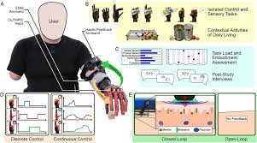

Testing & Evaluation
In theory using research and articles from professionals using similar prosthetics in this project:
The prosthetic achieved an average gesture recognition accuracy of around 90%.
Response time from muscle activation to prosthetic movement was around 138–150 milliseconds.
A small user study with six participants demonstrated reliable control and easy calibration.
Users were able to set up the device in under 3 minutes, making it practical for real-world use.

Slide 7
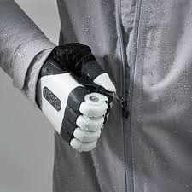
Performance Summary
Gesture accuracy: ~91.8%, comparable to professional commercial systems (92–96%).
Response time: <150 milliseconds, allowing smooth and responsive movement.
Total cost of materials: approximately £120, far below commercial alternatives allowing it to sell for lower prices.

Slide 8

Future Improvements
Adding haptic feedback sensors could allow users to 'feel' pressure and improve their ability to grip objects.
Better skin-contact materials would reduce irritation caused by sweat and residual limb movement.
Combining EMG with Force Myography (FMG) could increase accuracy to 97% or higher.
Future versions may support more gestures, higher durability, and improved real-world robustness.

Slide 9

Conclusion
The project demonstrates that a low‑cost, AI‑enabled prosthetic hand is both feasible and effective.
The system offers fast, accurate gesture recognition, comparable to commercial systems and can be built and can be maintained in low‑resource environments.
Using 3D printing and off‑the‑shelf electronics allows patients to afford prosthetics at a fraction of the usual cost.
This approach significantly improves accessibility and quality of life for individuals in resource‑limited regions.

